Slide 1
General Problem Solver (GPS)
Designed to emulate human problem solving protocols
Means-end Analyser
Developed over a 10 year period.
Reference:
Newell, A., and Simon, H.A. (1961) GPS, a Program that Simulates Human Thought. In E.A. Feigenbaum and J. Feldman (Eds) Computers and Thought, New York: McGraw-Hill, pp 279-93.

Slide 2
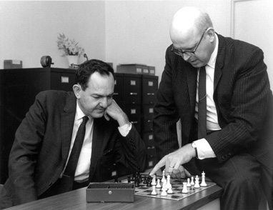

Slide 3
GPS
Could solve problems like
Missionaries and cannibals problem.
Three missionaries are travelling through an inhospitable landscape with their three native bearers. The bearers are cannibals, but it is the custom of their people never to attack unless the victims are outnumbered. Each missionary is aware of what might happen if the party is accidentally divided. The group reaches the bank of a wide, deep flowing river. The party has to cross it. One of the bearers chances upon a two-man dugout upturned in the mud. A terrible grin spreads across his face as he savours the implications of his find.

Slide 4
3 missionaries, 3 cannibals
Cannibals only attack if victims are outnumbered.
Have to cross river in 2 man dugout.
How to get all across without letting cannibals outnumber missionaries on either bank?

Slide 5
Probably used similar methods to GPS – build up sequence of river crossings one at a time, back-tracking occasionally when things go wrong.

Slide 6
GPS works by working out how to arrive at goal state from current state.
Similar problems – Tower of Hanoi
Trying to get from home to Sheffield University
Procedures selected according to their ability to reduce the observed difference between the current state and the goal state = means ends analysis

Slide 7
GPS designed to imitate human problem solving
  tries to identify a series of lesser problems, which if solved would lead to solution of main problem.
  The order in which goals and subgoals considered was similar to the way humans approached problems

Slide 8
GPS
  Search
    Start position
    Transitions
    Goal or solution position
    Heuristics
  Human resemblance?

Slide 9
GPS used heuristics (not algorithms)
Trial and error guided by tables telling it which moves to try first
  ‘Heuristic’ from greek word heuriskein (to discover)
  Archimedes shouted ‘Heurika’ (eureka) as water displaced from the bath.
  Like a rule of thumb
  ‘a process that may solve a given problem, but offers no guarantee of doing so, is called a ‘heuristic’ for that problem’
  - instead of working through all possible solutions, use short cuts ie. Rules that eliminate less likely candidates and allow concentration on those that seem more likely.

Slide 10
GPS – “general” because general problem solving methods separated from knowledge specific to task in hand.
Problem solving part (means end analysis)
Task dependent knowledge, collected in data structures forming task environment

Slide 11
AI techniques
Search – fundamental to traditional AI
Changing real world problem into a search problem
  Start position
  A set of transitions from one position to another
  Goal or solution position.

Slide 12
  Search – originally developed in AI, but now fundamental to computing.
  Combinatorial explosion and heuristics

Slide 13
Means-ends analysis
Involves detection of difference between current state and goal state
Once difference identified, an operator to reduce the difference must be found
But perhaps operator cannot be applied to current state
Subproblem of getting to state where operator can be applied
Operator may not result in goal state
Second subproblem of getting from new state to goal state

Slide 14
MEA
MEA process applied recursively
Each rule (operator) has
  LHS preconditions and RHS aspects of problem state changed.
  Difference table of rules and differences they can reduce.

Slide 15
Example:
Problem for household robot: moving desk with 2 things on it from one room to another.
Main difference between start and goal state is location.
Choose PUSH and CARRY

Slide 16
Move desk with 2 things on it to new room
 | Push | Carry | Walk | Pickup | Putdown | Place
Move object | * | *
Move robot |  |  | *
Clear object |  |  |  | *
Get object on object |  |  |  |  |  | *
Get arm empty |  |  |  |  | * | *
Be holding object |  |  |  | *

Slide 17
Operator | Preconditions | Results
PUSH (obj, loc) | at(robot,obj) &large (obj) &clear (obj) & arm empty | at(obj, loc) & at (robot, loc)
CARRY (obj, loc) | at(robot, obj) &Small (obj) | at(obj, loc) &at(robot, loc)
WALK(loc) | none | At(robot, loc)
PICKUP(obj) | At(robot, obj) | Holding(obj)
PUTDOWN(obj) | Holding(obj) | Not holding (obj)
PLACE(obj1, obj2) | At(robot,obj2) & holding (obj1) | on(obj1, obj2)
CARRY: preconditions cannot be met
PUSH: 4 preconditions
WALK to object, clear desk using PICKUP and PLACE. After PUSH objects not on desk. Must WALK to collect them and put on table using PICKUP and CARRY

Slide 18
Means-Ends Analysis
1. Compare CURRENT to GOAL. If no differences, return.
2. Otherwise select most important difference and reduce it by doing the following until success or failure is indicated.
Select an as yet untried operator O that is applicable to the current difference. If there are no such operators then signal failure.
Attempt to apply O to the current state. Generate descriptions of two states O-START a state in which O’s preconditions are satisfied and O-RESULT, the state that would result if O were applied in O-START.
If (FIRST-PART MEA (CURRENT,O-START) AND (LAST-PART MEA (O-RESULT, GOAL) are successful then signal success.

Slide 19
CONSTRAINT SATISFACTION AND PROPAGATION

Slide 20
Constraint Satisfaction (CS)
Constraint satisfaction is the process of finding a solution to a set of constraints that impose conditions that the variables must satisfy. A solution is therefore a vector of variables that satisfies all constraints.
Formally, a constraint satisfaction problem is defined by
  a set of variables X1, X2, …, Xn,
  a set of constraints C1, C2, …, Cn
Each variable Xi has a non-empty domain Di of possible values
A state of a given problem is defined by an assignment of values to some or all of the variables in the problem, i.e., {Xi=vi, Xj=vj, ….. }
An assignment that does not violate any constraint is called a consistent or legal assignment. A complete assignment is one in which every variable is mentioned. A solution to a CS problem is a complete assignment that satisfies all the constraints.

Slide 21
MAP COLOURING PROBLEM
Variables: The states WA, NT, Q, NSW, V, SA, T of a country.
Values: The states are to be coloured with the colours Red(R), Green(G) and Blue(B)
Constraint: No two neighbouring states can have the same colour.

Slide 22
MAP COLOURING PROBLEM
Domain of each variable is
Di = {R, G, B}
Constraint for NT and WA to not to have the same colour is
C -> NT ≠ WA
Allowable combinations are:
{(R,G),(R,B),(G,R),(G,B),(B,R),(B,G)}

Slide 23
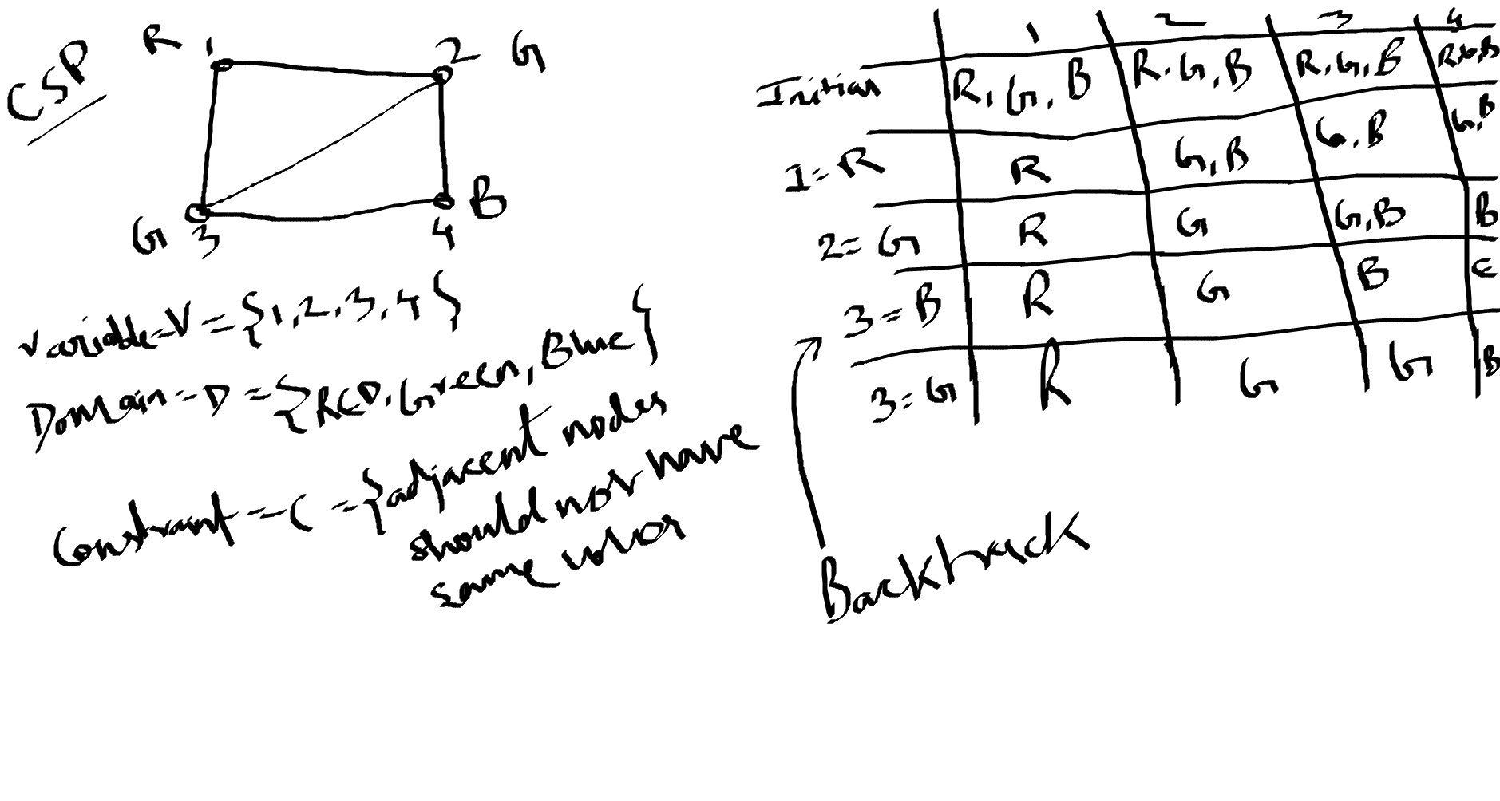

Slide 24
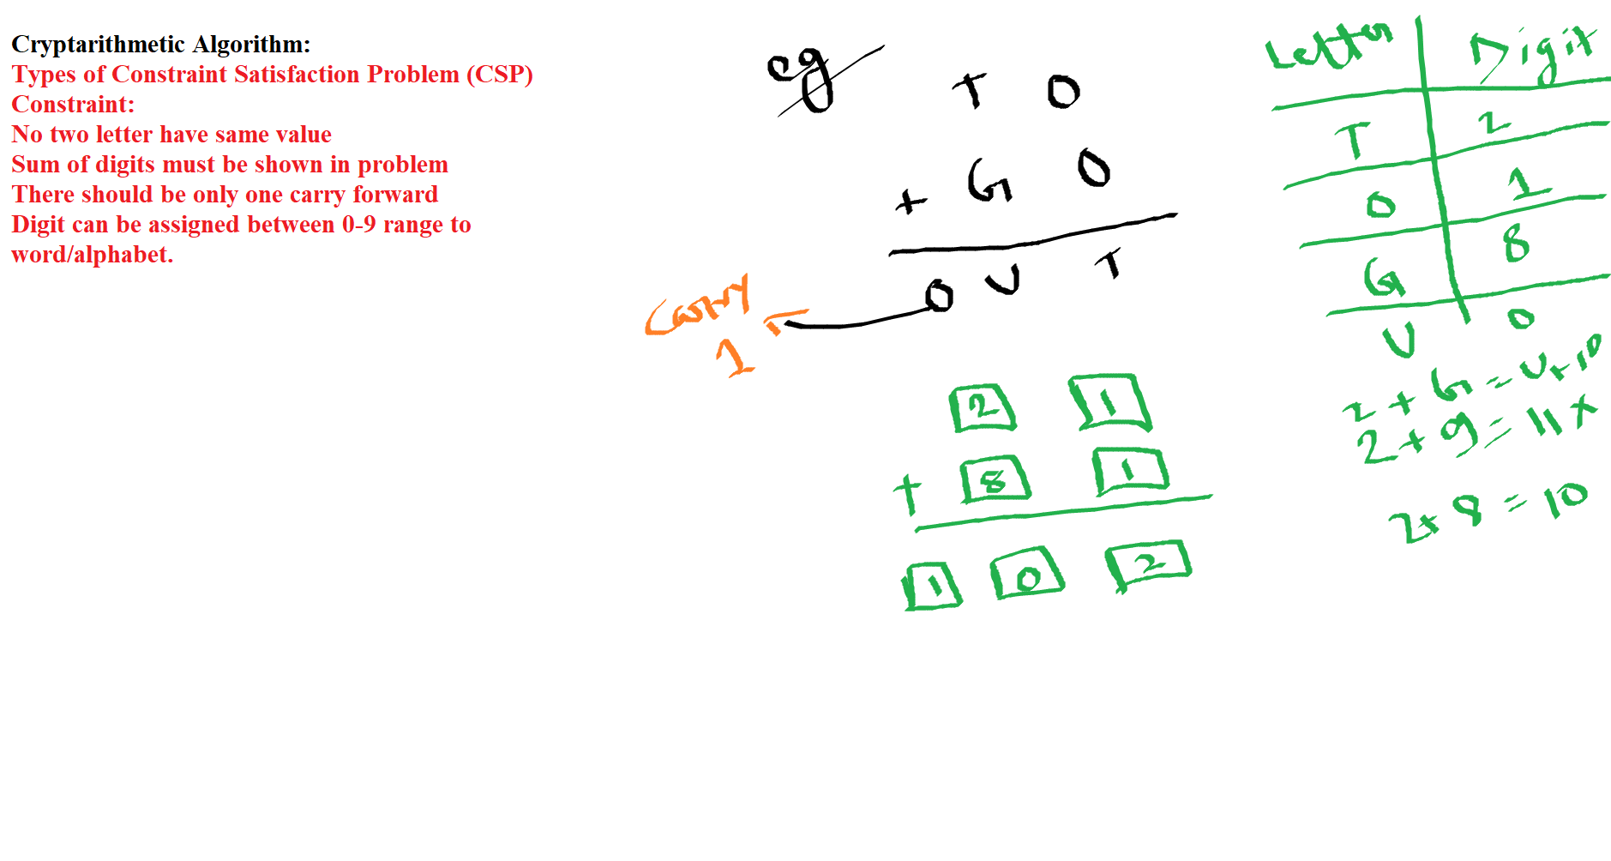

Slide 25
Using CS to Solve the
Map Colouring Problem
Supposing the current assignment is
{(WA ← R), (Q ← G), (V ← B)}
It does not lead to a solution.
WA | NT | Q | NSW | V | SA | T
RGB | RGB | RGB | RGB | RGB | RGB | RGB
R | RGB | RGB | RGB | RGB | RGB | RGB
R | GB | G | RGB | RGB | GB | RGB
R | B | G | RB | B | B | RGB

Slide 26
Using CS in Map Coloring
Contradiction that was
not detected
NT
Q
WA
NSW
T
SA
V
WA | NT | Q | NSW | V | SA | T
RGB | RGB | RGB | RGB | RGB | RGB | RGB
R | RGB | RGB | RGB | RGB | RGB | RGB
R | GB | G | RGB | RGB | GB | RGB
R | B | G | RB | B | B | RGB

Slide 27
Using CS in Map Coloring
Contradiction that was
not detected
NT
Q
WA
T
Detecting this contradiction requires
a constraint propagation technique
SA
NSW
V
WA | NT | Q | NSW | V | SA | T
RGB | RGB | RGB | RGB | RGB | RGB | RGB
R | RGB | RGB | RGB | RGB | RGB | RGB
R | GB | G | RGB | RGB | GB | RGB
R | B | G | RB | B | B | RGB

Slide 28
Constraint Propagation
… is the process of determining how the constraints and the possible values of one variable affect the possible values of other variables.
It consists of propagating the implications of a constraint on one variable onto other variables to detect inconsistencies such as the contradiction shown earlier and avoiding them.

